Slide 1
PM – Systems Analysis and Project Management
Cost Management

Slide 2
Project Cost Management Processes
Cost estimating: developing an approximation or estimate of the costs of the resources needed to complete a project
Cost budgeting: allocating the overall cost estimate to individual work items to establish a baseline for measuring performance
Cost control: controlling changes to the project budget
Information Technology Project Management, Fifth Edition, Copyright 2007

Slide 3
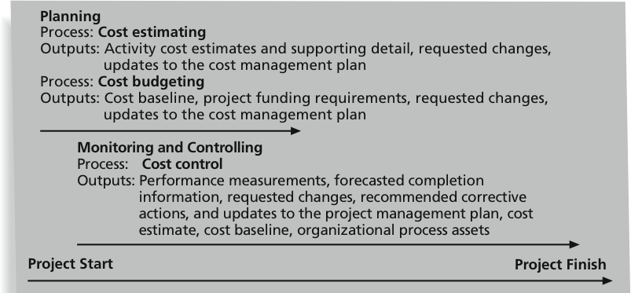
Figure 7-1: Project Cost Management Summary
Information Technology Project Management, Fifth Edition, Copyright 2007

Slide 4
Basic Terms of Cost Management
Most members of an executive board better understand and are more interested in financial terms than IT terms, so IT project managers must speak their language
  Profits are revenues minus expenditures
  Profit margin is the ratio of revenues to profits
  Life cycle costing considers the total cost of ownership, or development plus support costs, for a project
  Cash flow analysis determines the estimated annual costs and benefits for a project and the resulting annual cash flow
Information Technology Project Management, Fifth Edition, Copyright 2007

Slide 5
Basic Terms of Cost Management
Tangible costs or benefits are those costs or benefits that an organization can easily measure in dollars (aka Hard dollars)
Intangible costs or benefits are costs or benefits that are difficult to measure in monetary terms (aka Soft Dollars)
Sunk cost is money that has been spent in the past; when deciding what projects to invest in or continue, you should not include sunk costs
Information Technology Project Management, Fifth Edition, Copyright 2007

Slide 6
Basic Terms of Cost Management (continued)
Reserves are dollars included in a cost estimate to mitigate cost risk by allowing for future situations that are difficult to predict
  Contingency reserves allow for future situations that may be partially planned for (sometimes called known unknowns) and are included in the project cost baseline
  Management reserves allow for future situations that are unpredictable (sometimes called unknown unknowns)
Reserves are usually determined by the Finances
Information Technology Project Management, Fifth Edition, Copyright 2007

Slide 7
Structured Project cost
Purchasing
  Hardware
  Software
  First year maintenance
  Consulting services
Internal cost
  Development
  Testing
  Training
  Traveling

Slide 8
Project Budget
Project cost is estimated and presented to the management
Approval may include some contingency or management reserve (do not expect much!)
That is your project budget – money you are given to complete the project

Slide 9
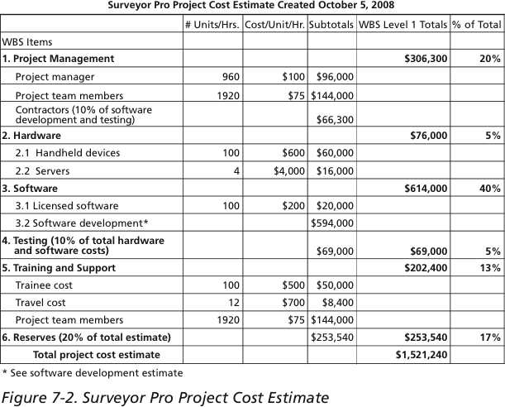
Example of structured budget
Information Technology Project Management, Fifth Edition, Copyright 2007

Slide 10
Cost Budgeting with WBS
Cost budgeting involves allocating the project cost estimate to individual work items over time
The WBS is a required input to the cost budgeting process since it defines the work items
An important goal is to produce a cost baseline
  A time-phased budget that project managers use to measure and monitor cost performance
Information Technology Project Management, Fifth Edition, Copyright 2007

Slide 11
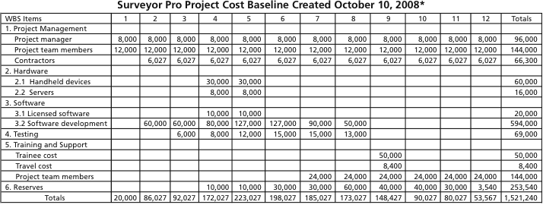
Project Cost Baseline
*Numbers are rounded, so some totals appear to be off.
Information Technology Project Management, Fifth Edition, Copyright 2007

Slide 12
Cost Control
Project cost control includes:
  Monitoring cost performance
  Ensuring that only appropriate project changes are included in a revised cost baseline
  Informing project stakeholders of authorized changes to the project that will affect costs
Many organizations around the globe have problems with cost control
Information Technology Project Management, Fifth Edition, Copyright 2007

Slide 13
Total cost of ownership
Includes development cost and post-implementation cost
Post-implementation cost
  Internal maintenance cost
  Vendor annual support cost

Slide 14
Project Benefits
Detailed analysis of changes in:
  Workflow
  Materials
  Human resources
  Time to implement business functions
Client service excellence
Information security and other features

Slide 15
Cost-Benefit Analysis
Management want to see:
Cost
  Development cost
  Total cost of ownership
Benefits
  Hard dollars
  Soft dollars

Slide 16
Cost-Benefit Analysis
Benefits
  Non-financial gains
    Improved security, usability, performance, public relationships
  Financial gains
    Soft dollars, e.g. saving employees’ time
    Hard dollars, e.g. reduced expenses for materials, such as paper, toners. Or reduced number of employees

Slide 17
CBA – some definitions
Cash flow – money in or out
Net present value – expected net gain or loss in future cash flow discounted by present time (present value of money is higher than future value)
Payback period – amount of time it will take to recap investments into the project
Return On Investment (ROI) : (Revenue – Cost)/ Cost

Slide 18
Cost estimation tools and techniques
Analogous estimate, aka top-down technique
  Use the actual cost of previous similar project as the basis
  Is fast but not reliable
  Some real and important differences may be overlooked
Bottom-up estimate
  Estimate first individual work items
  Requires detailed WBS
Parametric modeling
  Use established standard on work unit cost

Slide 19
Problems with cost estimate
Estimates are done too quickly
  Not sufficient time for estimate may result in wrong estimation
Lack of estimating experience
  Not detailed enough WBS
People are biased toward underestimation
  Senior people estimate based on their own abilities, but junior developers are not so effective
Management desire accuracy
  Management may push to minimize the cost

Slide 20
Determining the budget
When estimate cost is confirmed for execution it is known as project budget
This is allocating cost to individual work units on WBS
Creating baseline which will record time-cost planned values

Slide 21
Defining cost estimate with MS Project
Fixed costs
  Fixed cost may be assigned to the task with no dependency on work efforts
  Often is made for material resources
Variable cost
  This cost is defined for work units performed by developers
  Each detailed task should be assigned to a person
  Work efforts in units (days, hours) are estimated
  Cost per unit established
View Cost at the Project Summary report

Slide 22
CBA for Security Projects
Security projects normally do not bring hard dollars
Look for soft dollars when you are thinking about the project benefits:
  Improved security
    Always expected but you should prove it. Perform security risks analysis
  Regulatory compliance
    Be compliant with the government regulations is mandatory thing for the company
  Best industry practice
    Be on the top to retain competitive image
  Responding to security incidents
    Virus infection, policy violation, etc. must be addressed
  Responding to audit recommendation
    No choice, must be addressed

